Slide 1

Simply online
Simple way to connect

Slide 2
Agenda
Agenda​
Team Member Roles and Responsiblities​
Improvements made from Professor Feedback​
Project Description​
Team Working Agreement​
Personas​
Minimal Viable Product (MVP)​
Technologies​
Algorithms​
Diagrams​
Sprint 5 Recap​
Product Backlog​
Sprint6 Backlog​
Metrics​
Retrospective​
Sprint 7​
Project Demo – Sprint 6​
Github link​
Live Application Demo

Slide 3
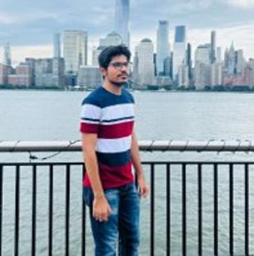
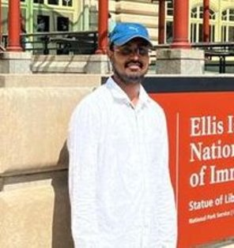
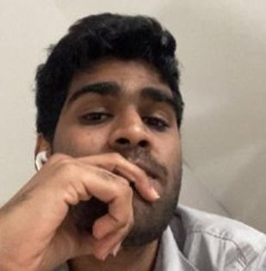
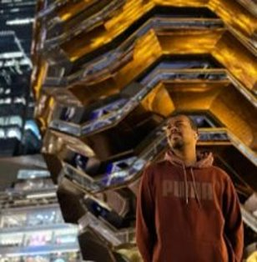
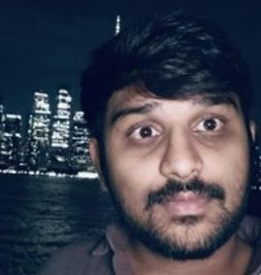
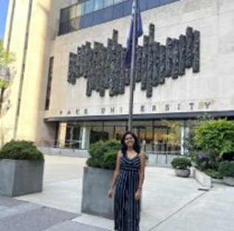
Team Members
Amarendra Reddy
Developer
Pruthvi Raj Reddy
DBA
Mounik
Developer
Ajay kumar
Full Stack Developer
Raviteja Reddy
Developer
Sreeja Reddy
Quality Analyst

Slide 4

Improvement from Professor’s feedback
We incorporated the professor’s feedback and make improvements to the presentation. ​
Action items in retrospective.​
Metrics​
Stories Points​
Test Cases

Slide 5
Project Description
Simply Online is a web application that aims to simplify the process of online classes. This application allows lecturers to create virtual rooms and share the room id with their students for seamless connectivity. Using webRTC technology, simply online allows group video-sharing features and screen-sharing capabilities. This application allows lecturers to easily take attendance with just a click of a button. This platform includes features like automatic attendance marking and auto transcript generation to eliminate the need for manual tracking and notes taking. Overall, simply online offers a comprehensive and user-friendly solution for educators and students to enhance their online learning experience.

Slide 6
Team Working Agreement
Participation:​
All the team members are expected to involve in project discussions and attend the meetings promptly. Absence during multiple meetings will affect the team’s performance and efficiency. ​
The team member can discuss beforehand with the team leader if he/she is going to miss the meeting or make it up for it before the next meeting is scheduled.
​
Communication:​
The team will communicate with each other using WhatsApp group and meetings will be scheduled on Zoom.​
Jira software will be used to track the assigned tasks. For any dependency on another task, mention it in the task comments.​
Task management, bugs, sprint planning, and meeting minutes will be tracked in Jira.​
To share the final deliverables, Google docs will be used where all the team members can edit the document.
Work Division:​
The entire project work should be divided into equal parts, and equal responsibilities should be given to all the team members.​
Each team member should complete their division of work before the deadline. If they are unable to complete the work on time, that hinders the performance of the entire team. If in case a team member is facing trouble and issues at some point, they can share it with others so that they can help each other and complete the work before the deadline.​
​
Meetings:​
All the team members will meet on zoom virtually every Tuesday and Friday. All the team members must be present, as attendance is mandatory unless there is an exceptional case.​
The team leader would be responsible for sending meeting details and conducting the meeting.​
A meeting track or meeting minutes report would be listed after every meeting to keep track of the project and its progress.​
Every team member is expected to come up with ideas, participate in the discussion, and give an update on their progress for their part of the work.
TEAM MEMBERS​
AJAY KUMAR​
AMARENDAR​
RAVI TEJA​
SREEJA​
PRUTHVI RAJ​
MOUNIK

Slide 7
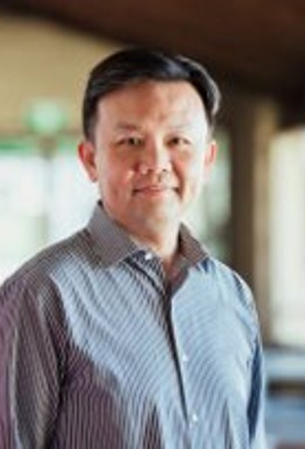
Persona
Name: Professor James​​
Age: 45​​
Occupation: University Professor​​
Profile:​
James is a tenured professor in the Computer Science department at a large university.
He teaches both undergraduate and graduate-level courses and conducts research in his field.
Due to the COVID-19 pandemic, his classes have been moved online, and he uses various platforms to deliver lectures, holds office hours, and communicate with his students.
He lives with his spouse and two children, who are also attending school virtually.
Goals and Motivations:​
Deliver high-quality lectures and course material to his students​ Engage his students and create a dynamic and interactive virtual classroom environment.​
Ensure that his students are keeping up with the coursework and meeting their learning objectives.​
Provide effective feedback and support to his students.

Slide 8

Persona
Name: Sarah​
Age: 24​
Occupation: College student
Profile:​
Sarah is a full-time student pursuing a degree in psychology. Due to the COVID-19 pandemic, her classes have been moved online, and she uses Zoom to attend lectures, participate in group discussions, and communicate with her professors and classmates. ​
She lives in a small apartment with roommates and shares a room with one of them. ​
She has a busy schedule and often has to balance her coursework with a part-time job and other responsibilities.
Goals and Motivations:​
Attend all her classes and be an active participant in class discussions​ Stay organized and manage her time effectively to meet assignment deadlines.​
Have a reliable and user-friendly platform for attending virtual classes. Connect with her professors and classmates, and build a community within her course

Slide 9

Persona
Name: Ishika​
Age: 27​
Occupation: Elementary school teacher
Profile: ​
Ishika is a dedicated elementary school teacher who loves working with children. She has been teaching for three years and is always looking for ways to improve her classroom management and student engagement.
Ishika is originally from India but moved to the US with her family when she was a child. She is fluent in English and Hindi and enjoys cooking traditional Indian dishes in her free time
Goals and Motivations:​
Ishika is a dedicated elementary school teacher who loves working with children. She has been teaching for three years and is always looking for ways to improve her classroom management and student engagement. Ishika is originally from India but moved to the US with her family when she was a child. She is fluent in English and Hindi and enjoys cooking traditional Indian dishes in her free time​
Ishika’s main goal is to create a safe and engaging learning environment for her students. She wants to be able to take attendance quickly and efficiently so she can spend more time teaching and less time on administrative tasks. Sarah is also motivated by the opportunity to track student attendance and identify patterns that might indicate a need for additional support.

Slide 10

MINIMAL VIABLE PRODUCT

Slide 11
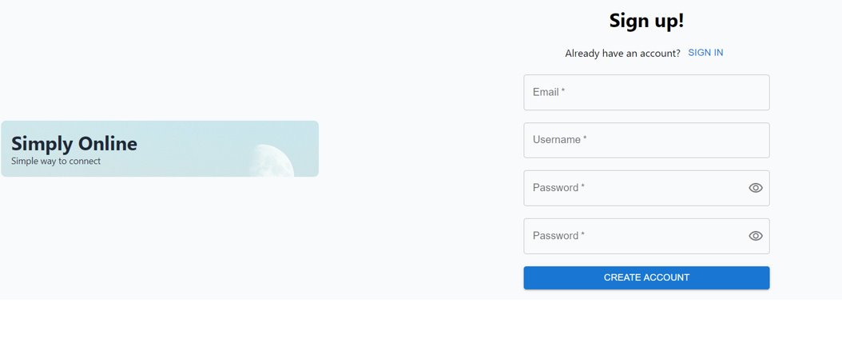
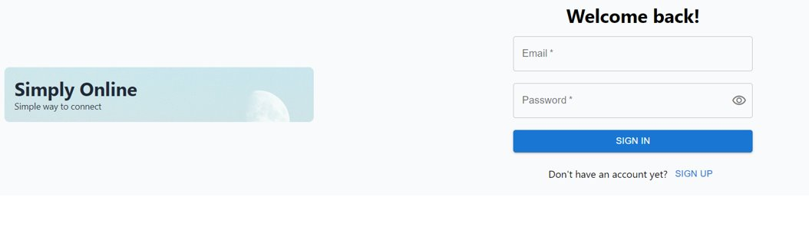
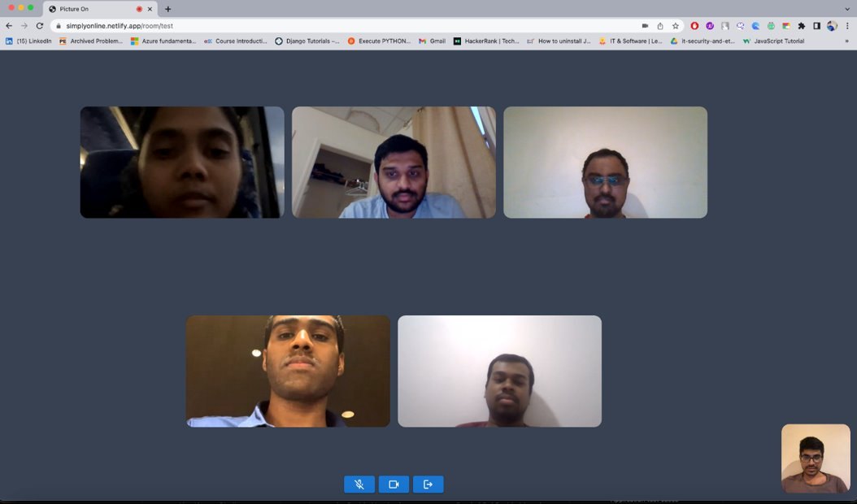

Slide 12
















Technologies

Slide 13
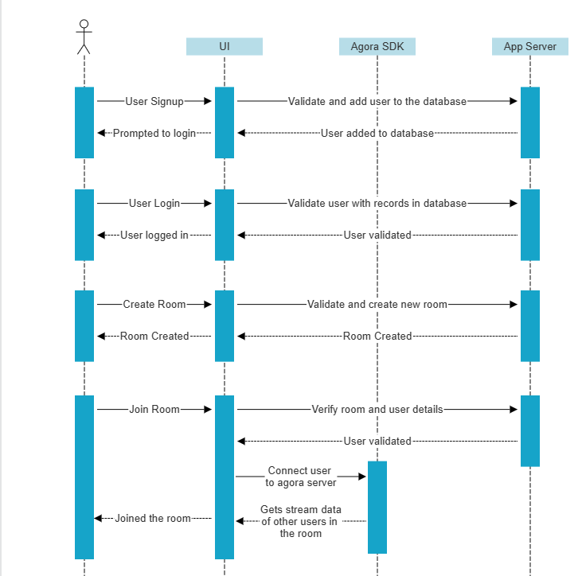
Sequence Diagram
changed

Slide 14
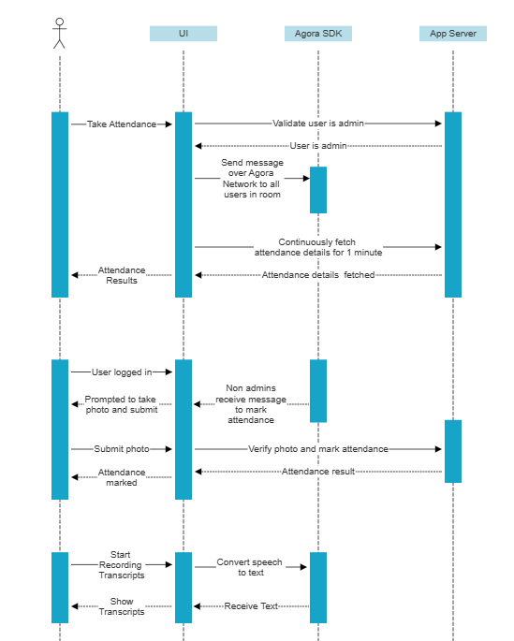
Sequence Diagram
changed

Slide 15
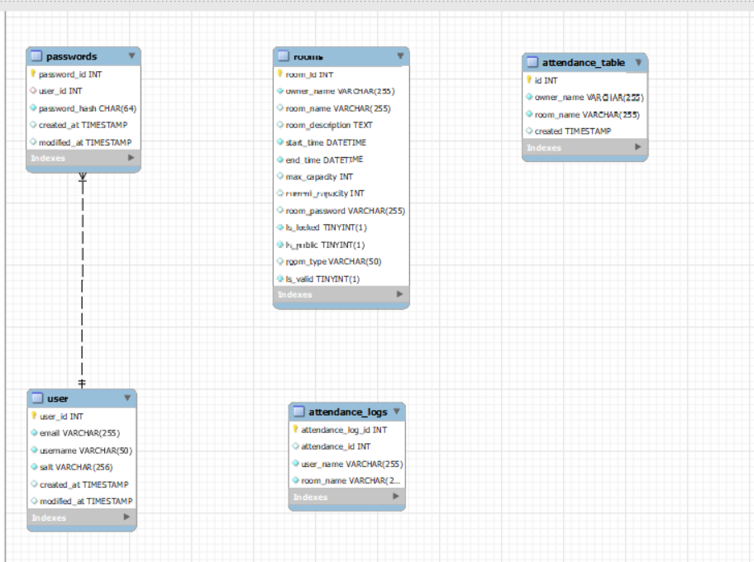
ER Diagram
changed

Slide 16

changed
Sprint-5 Recap
Create login and signup pages
Implement backend authentication using JWT token
Integration of authentication with existing application

Slide 17
changed
Product backlog &
Acceptance criteria
Userstory | Acceptance Criteria
Enable ScreenSharing feature | As a user Given user clicks on screen share button. Then user should be able to share screen.
 | As a user Given user is logged in as non admin, Then user should not see screen share button
 | As a user Given user is logged in as admin. Then user should see screen share button
Mark Attendance feature production deployment | As a user Given user is in https://simplyonline.tech And user is in online call. When admin requests for attendance And the user see popup asking to take a picture And the user takes photo And the user clicks on submit Then user should see the message "Attendance Marked Successfully"

Slide 18
changed
Product backlog & Acceptance criteria
User Story | Acceptance Criteria
Test live application with many users | As a user Given user joins a room with multiple users When Host provides proper input to the APIs Then user should see no lag
Deploy application on public server | As a user Given Host is on https://simplyonline.tech Then Host should see simplyonline UI And Host should be able to login to application
Create individual Docker images for Front end, back end and face recognition | As a developer Given Host is logged into the server And Host should pull docker images from dockerhub When user runs docker images Then application should be deployed in server

Slide 19
changed
Sprint 6 backlog
STORY ID | USER STORY | STORY POINTS
SIM-21 | Enable screen sharing feature | 20​
SIM-39 | Mark Attendance feature production deployment | 40
SIM-40 | Test live application with many users | 20
SIM-49 | Deploy application on public server | 40
SIM-48 | Add transcript functionality | 20
SIM-50 | Create individual Docker images for Front end, back end and face recognition | 20

Slide 20
changed
Test Cases
Unit to test​ | Scenario​ | Expected Result​
Public deployment | Check simplyonline.tech for deployed application | User will see simplyonline application and be able to login to application
Screenshare | User shares his screen | Other users in the call should be able to see the shared screen
Screenshare | User logged in as non admin | User should not see screen share button
Screenshare | User logged in as admin | User should see screen share button

Slide 21
changed
Completed and not completed tasks
STORY ID​ | USER STORY​ | STORY POINTS​ | Status​
SIM-21 | Enable screen sharing feature | 20​ | Done​
SIM-39 | Mark Attendance feature production deployment | 40 | Done​
SIM-40 | Test live application with many users | 20 | Done​
SIM-49 | Deploy application on public server | 40 | Done​
SIM-48 | Add transcript functionality | 20 | In Progress
SIM-50 | Create individual Docker images for Front end, back end and face recognition | 20 | Done​

Slide 22

Metrics

Slide 23
Team Velocity Report
changed

Slide 24
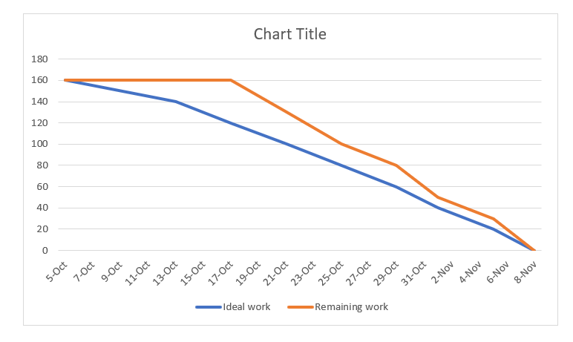
Sprint Burndown Chart

Slide 25
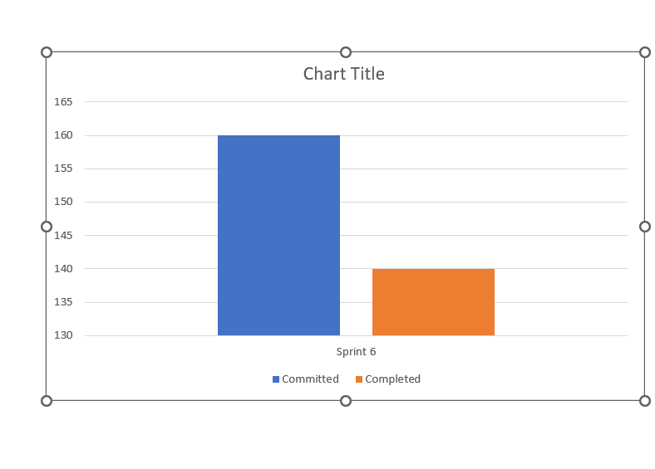
Committed and Completed Ratio
changed

Slide 26
Retrospective
What went well:
We successfully completed all the user stories and tasks that we committed to for this sprint
What didn’t go well:
Sprint ceremonies, such as daily stand-ups or sprint planning, were not as effective as desired.
Action Steps:
Create a well-structured agenda for each meeting. Share it with participants in advance so they can come prepared.
Set time limits for each agenda item and for the entire meeting. Stick to the schedule to prevent meetings from dragging on.

Slide 27
changed
Sprint 6
STORY ID​ | USER STORY​ | STORY POINTS​
SIM-48 | Add transcript functionality​ | 20​
SIM-37 | Add chat option | 13
SIM-51 | Technical paper | 13
SIM-52 | Deployment Document | 13

Slide 28

Group call

Slide 29
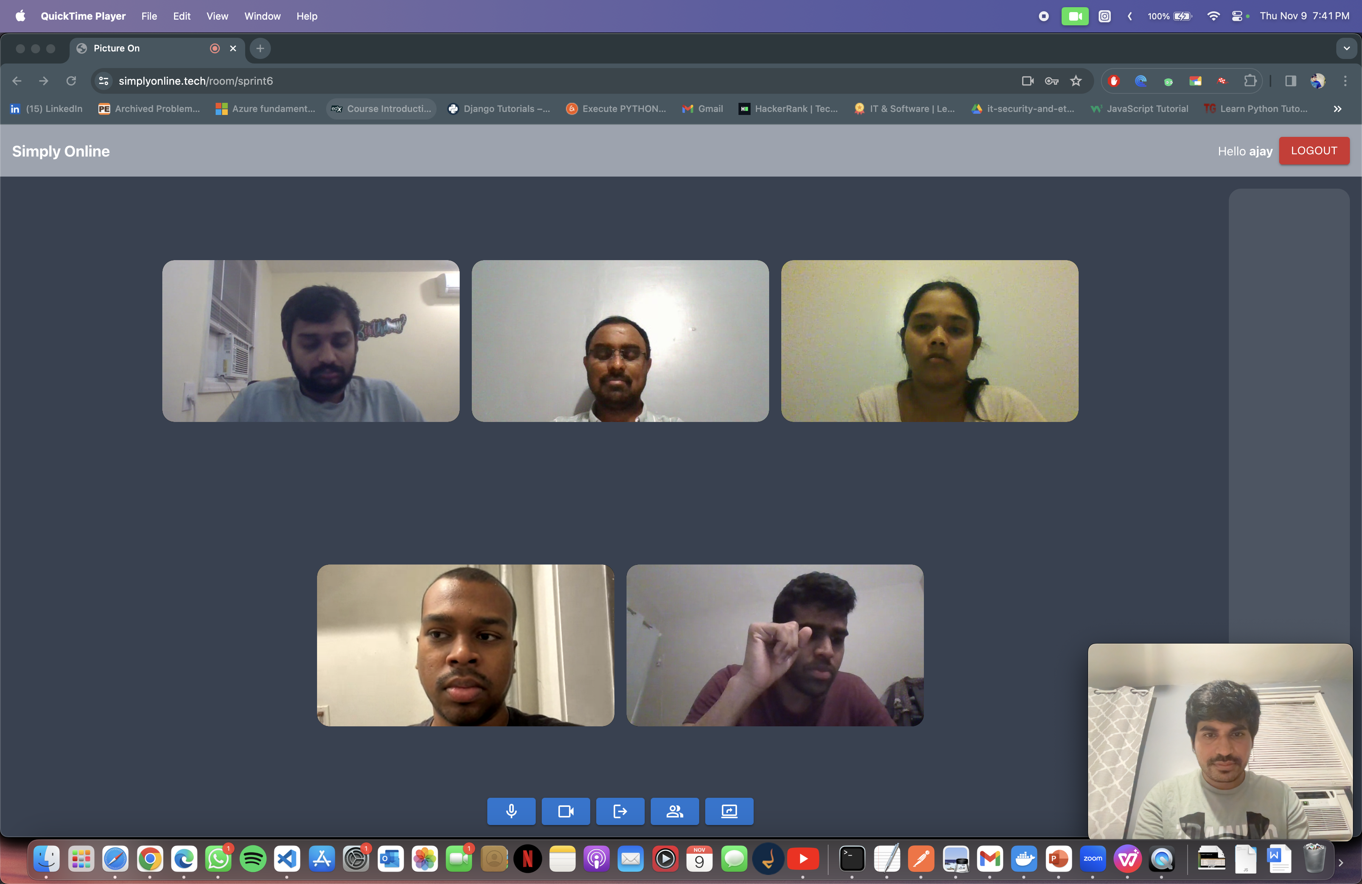

Slide 30
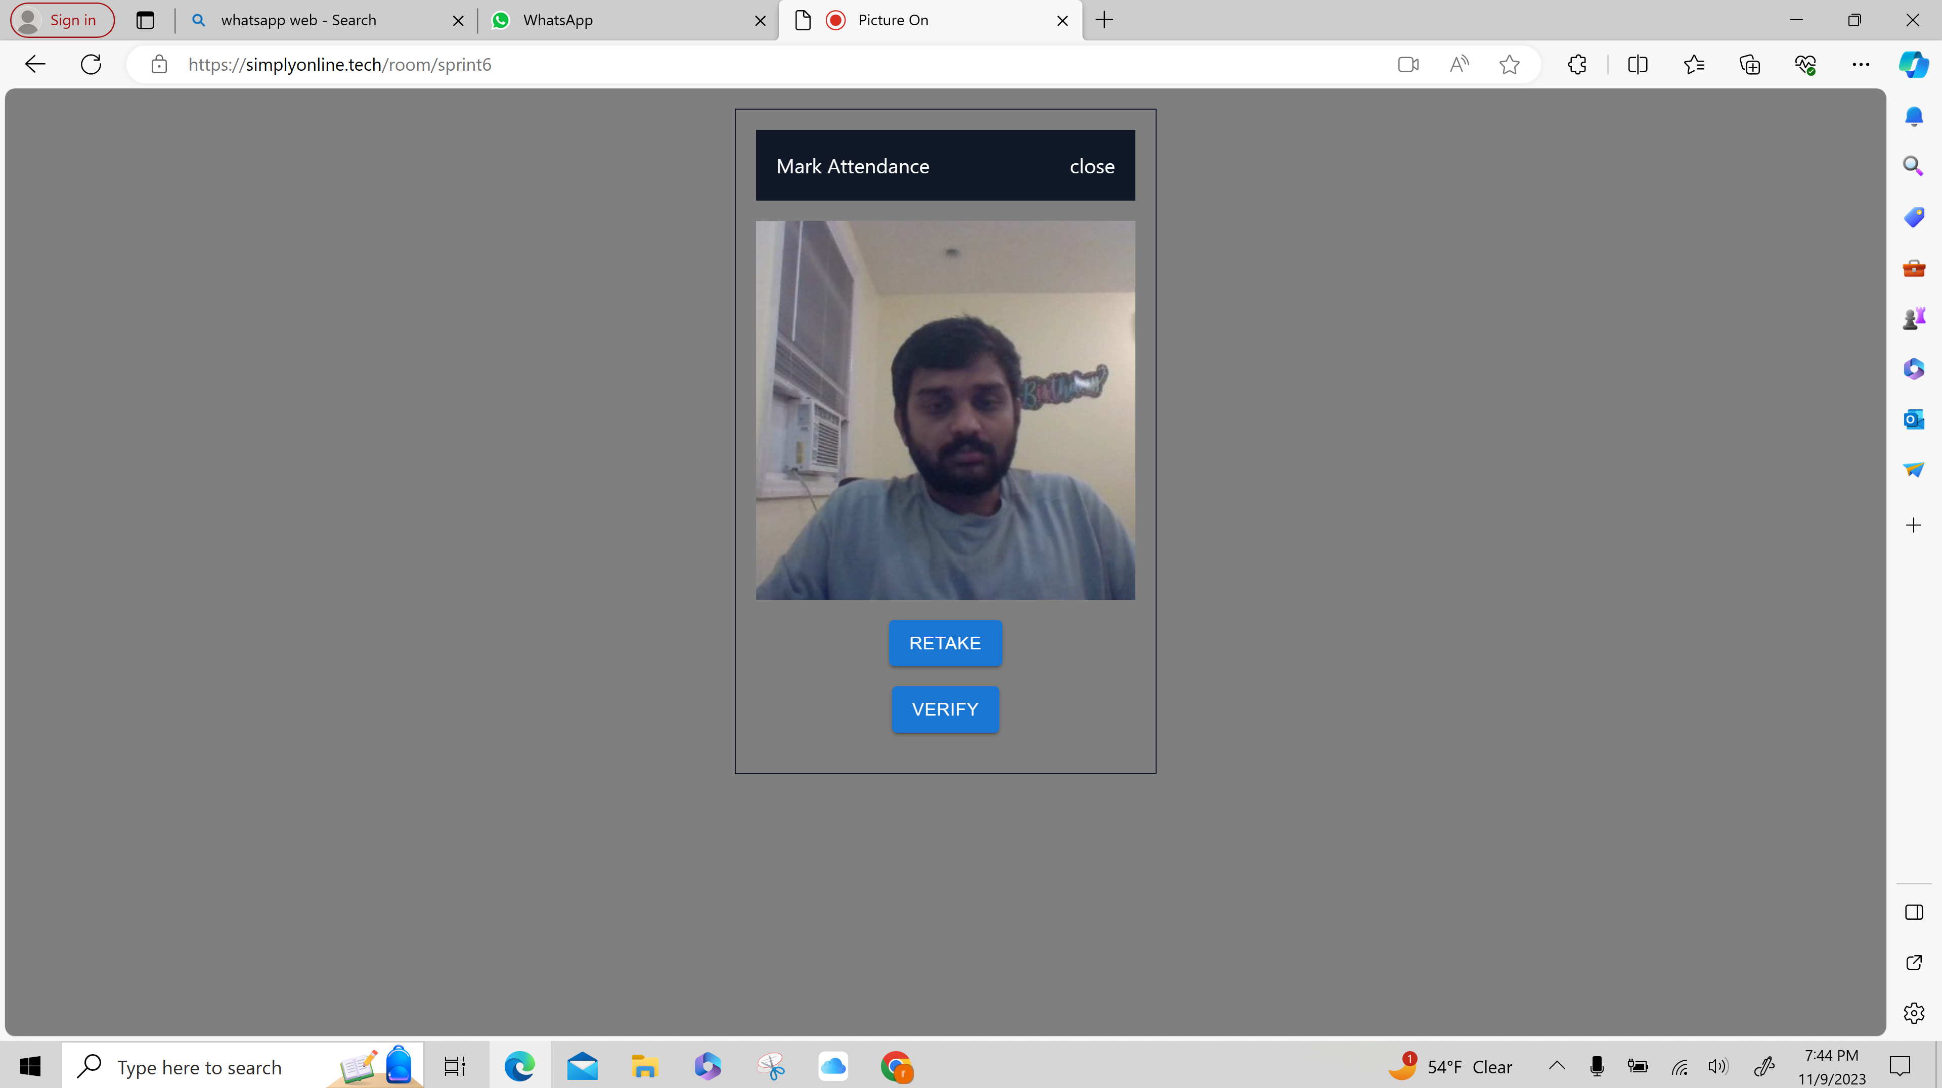
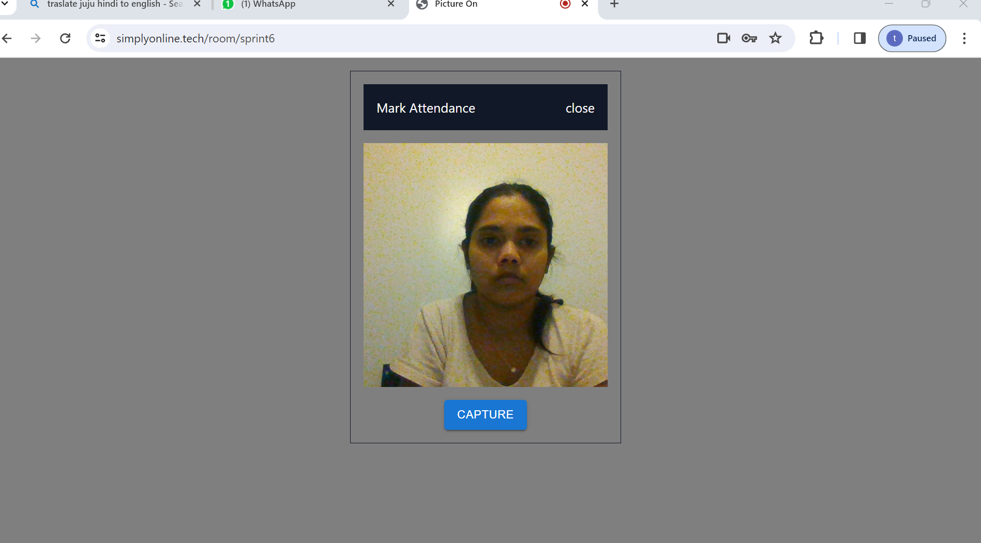
Mark Attendance/verify
This screen allows user to capture the photo and verify that it is the same user or not

Slide 31
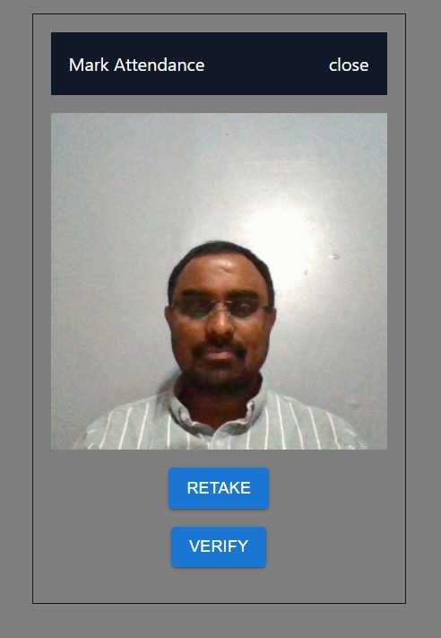
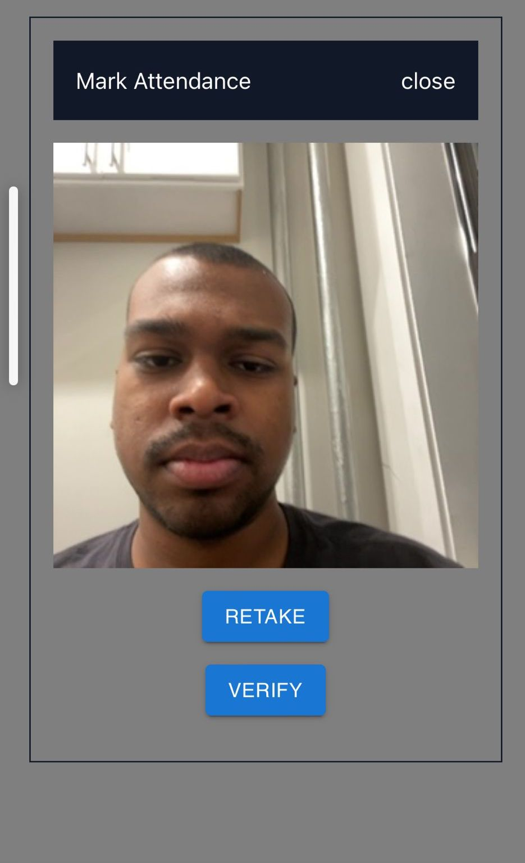
This screen allows users to capture and verify their face for mark attendance

Slide 32
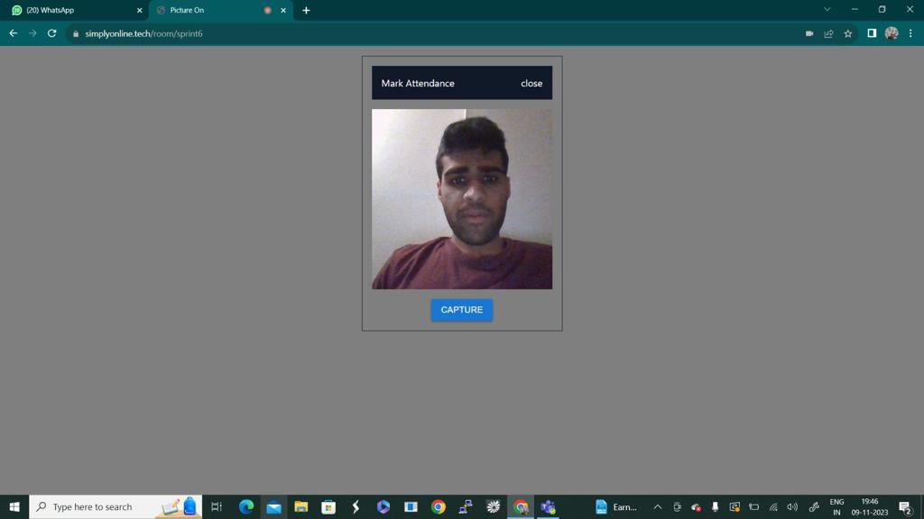
User gets button to capture their face

Slide 33
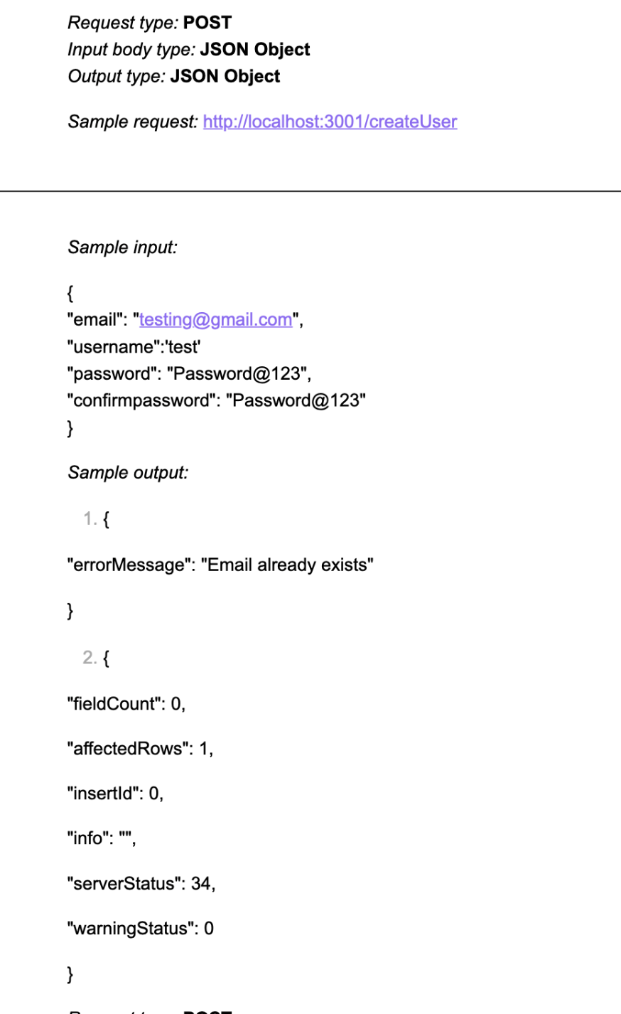
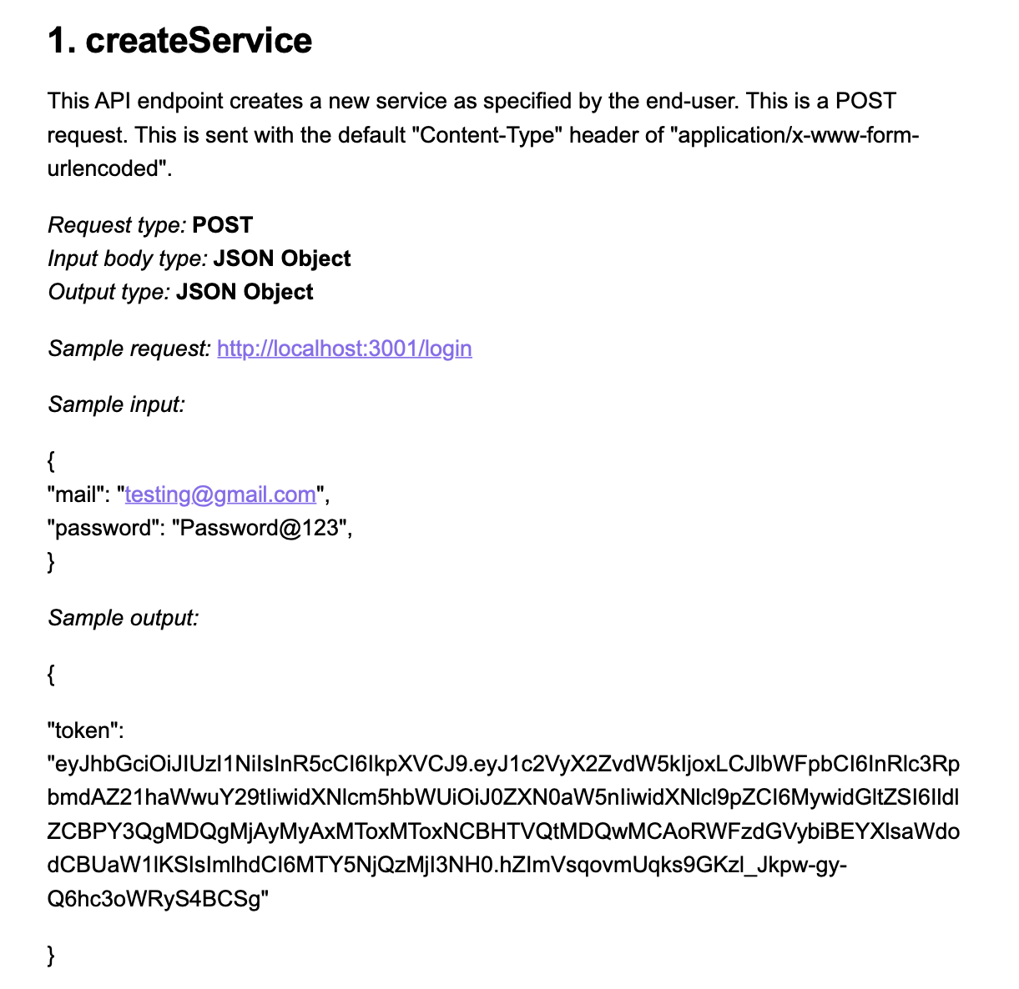
API for login and signup

Slide 34
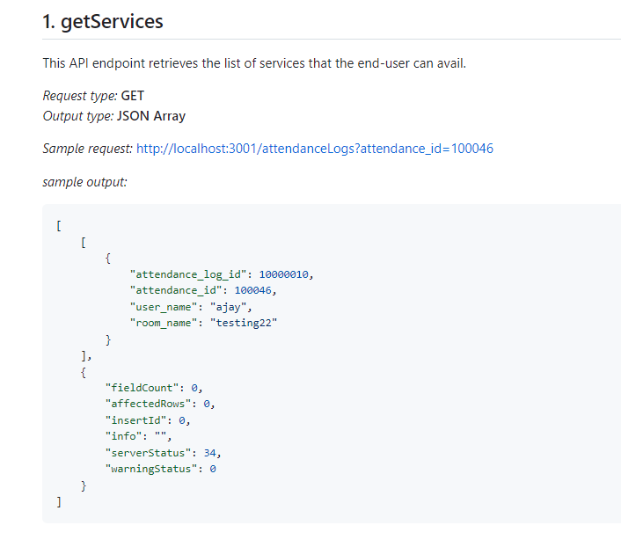
getService Api’s

Slide 35
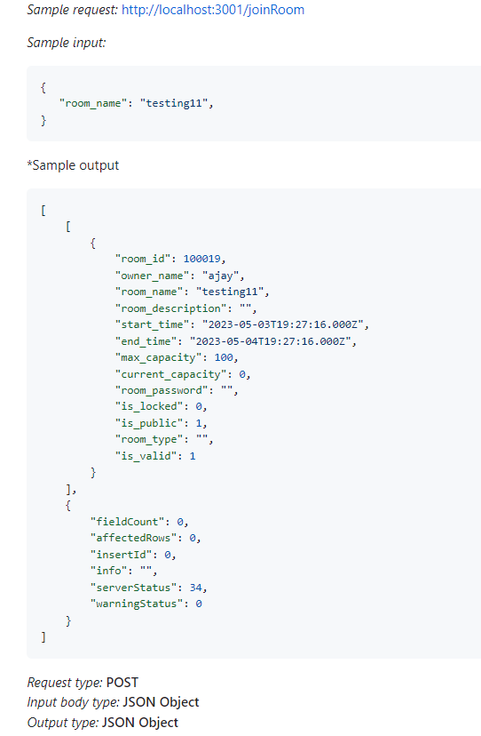
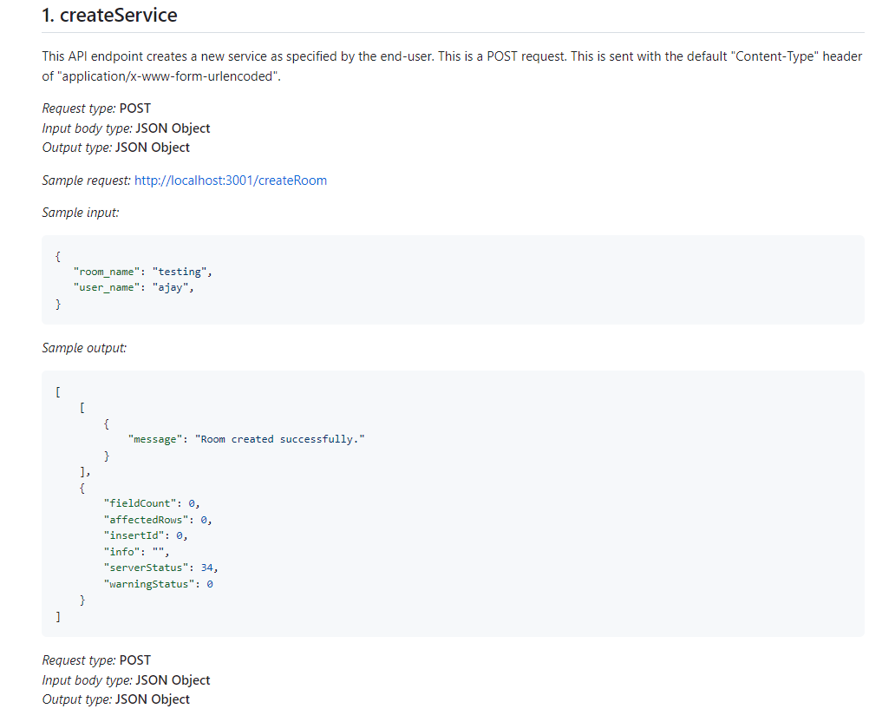
Api’s

Slide 36
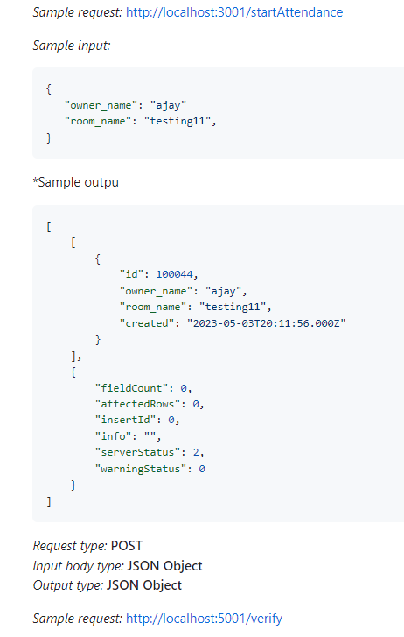
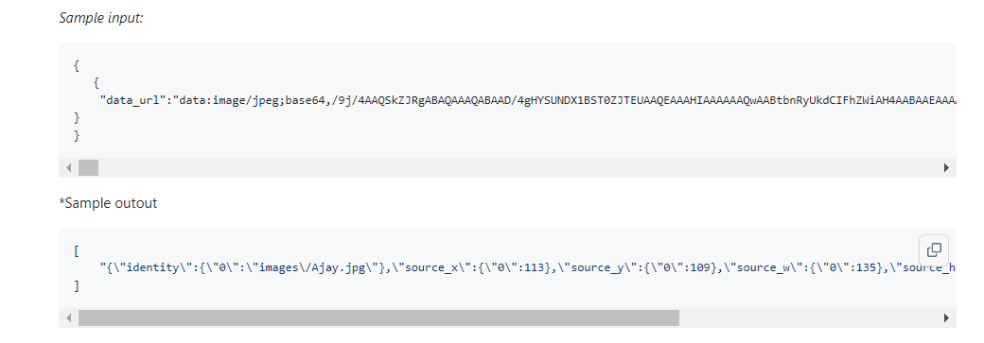
Api’s

Slide 37
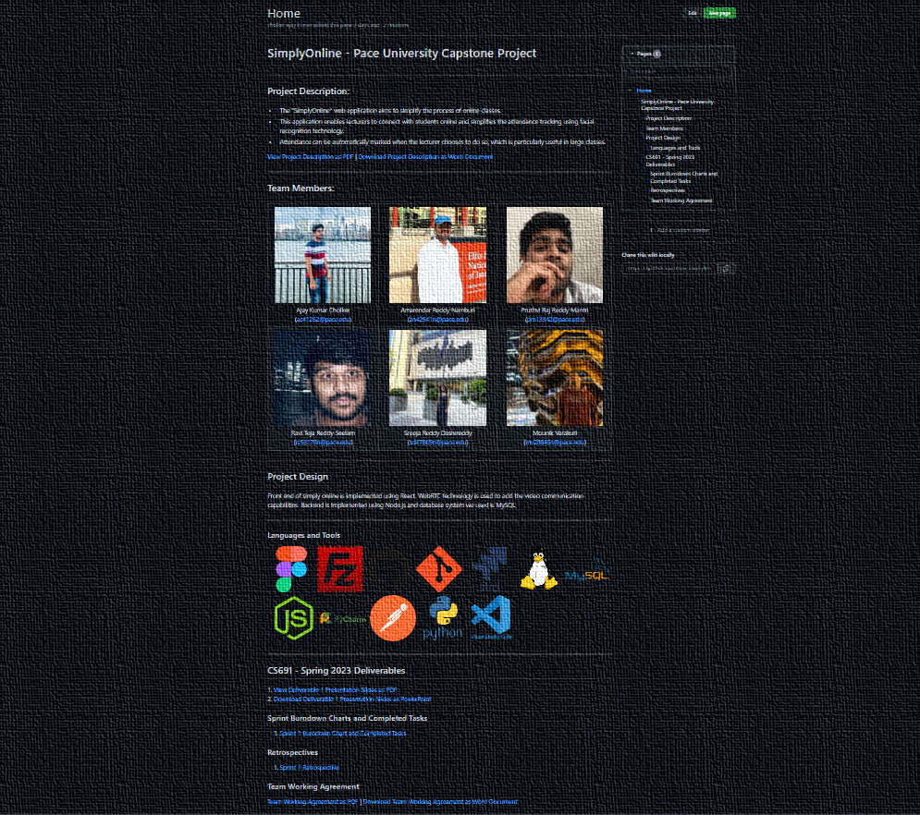
WIKI PAGE
https://github.com/htmw/SimplyOnline/wiki

Slide 38
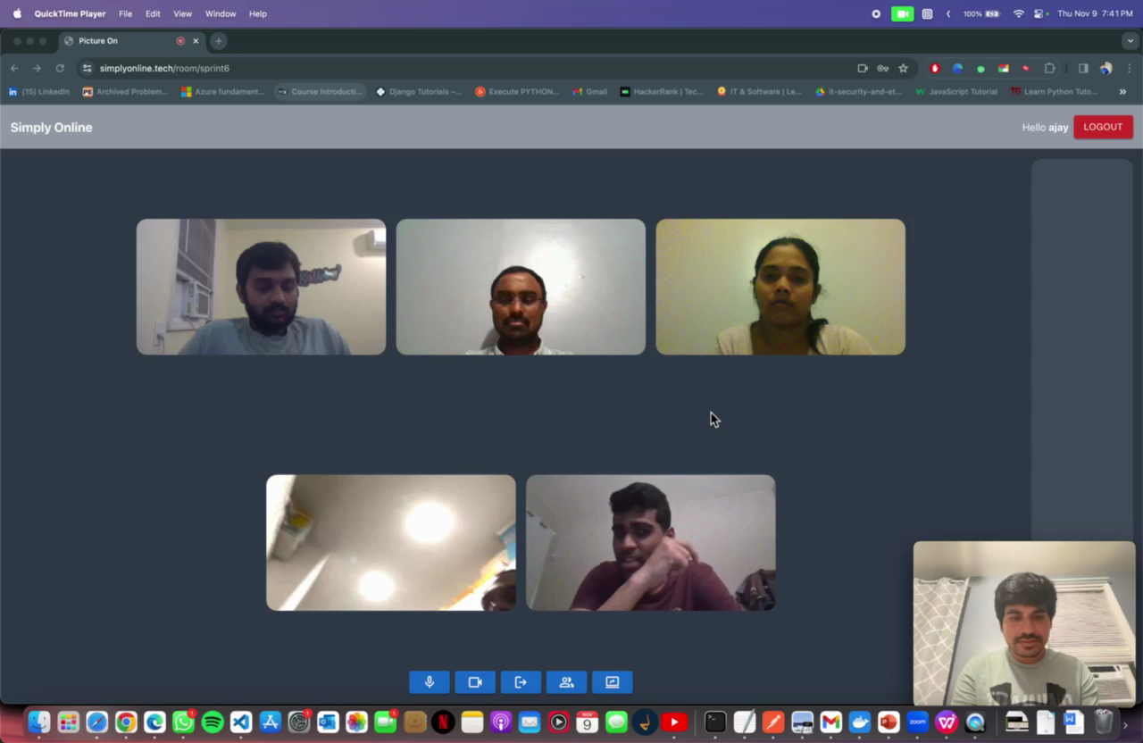
Demo

Slide 39
Thank You

